Slide 1
R O P
Roles of procedures & some other things you might need to know about MUN

Slide 2
What is MUN? What do we do in MUN?
MUN – Model United Nations
对联合国和其他多边机构的仿真和模拟

Slide 3
Introduction of the staff
Director(DIR)
Chair
Rapporteur
Assistant Director
Volunteer(VOL)
Secretary General（SG）
Faculty Advisor(FA)
Delegate(DEL)--Facilitate the conference

Slide 4
Before meeting
Topic
Region
BG ( Background Guide)
Academic preparation
PP ( Position paper)
e.g. Empowerment of Women in the Economic Field

Slide 5
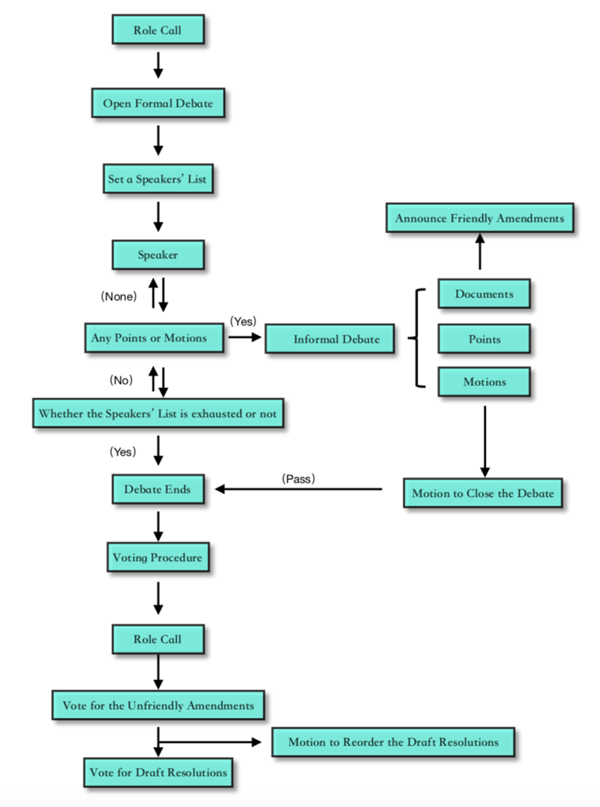
Committee session

Slide 6
Role Call
1. The rapporteur will do the Roll Call in alphabetic order
2. Delegates should raise their placards and answer “present” when their countries' names are called
3. Delegates who are late for the Roll Call should send a note to the Dais to show the presence.

Slide 7
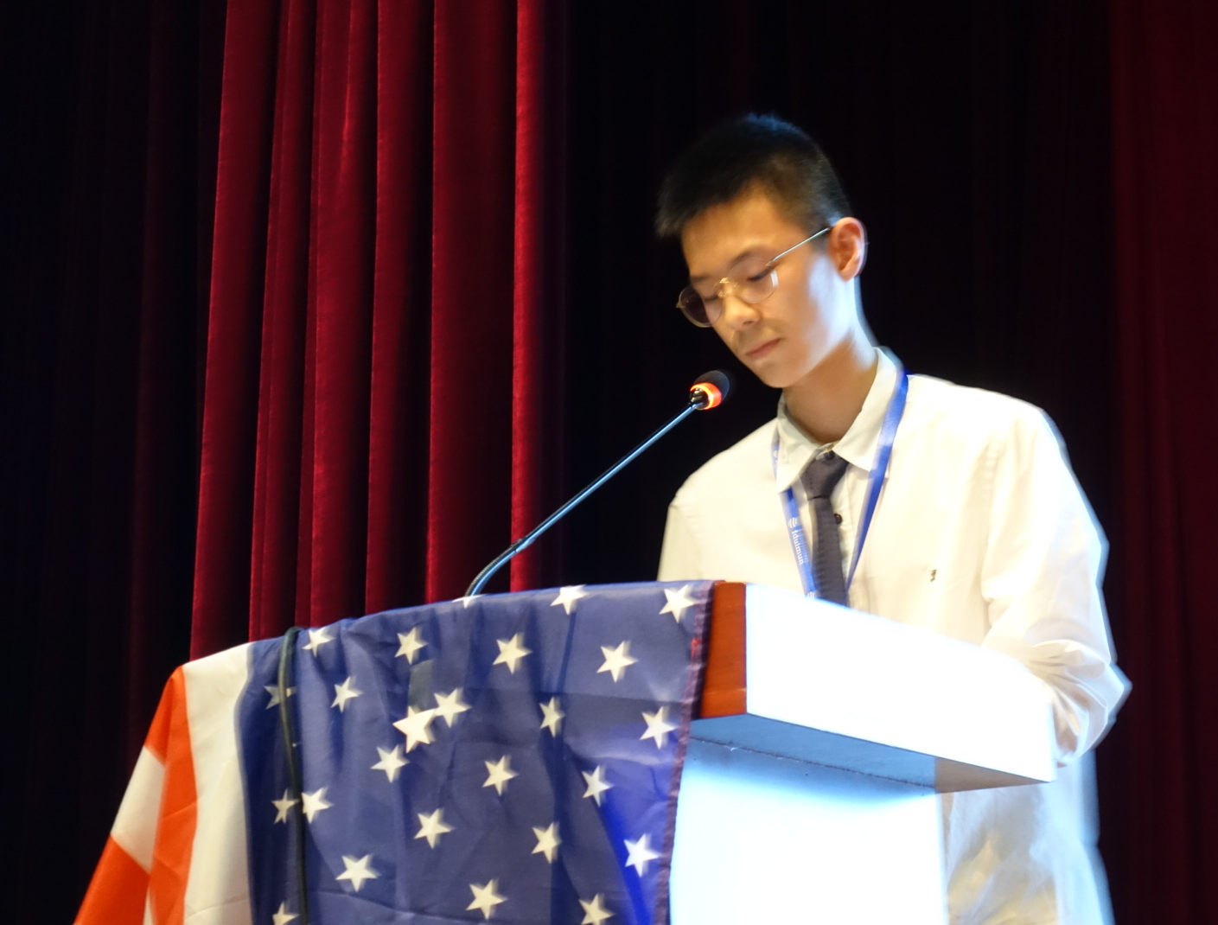
Main Speakers' list

Slide 8
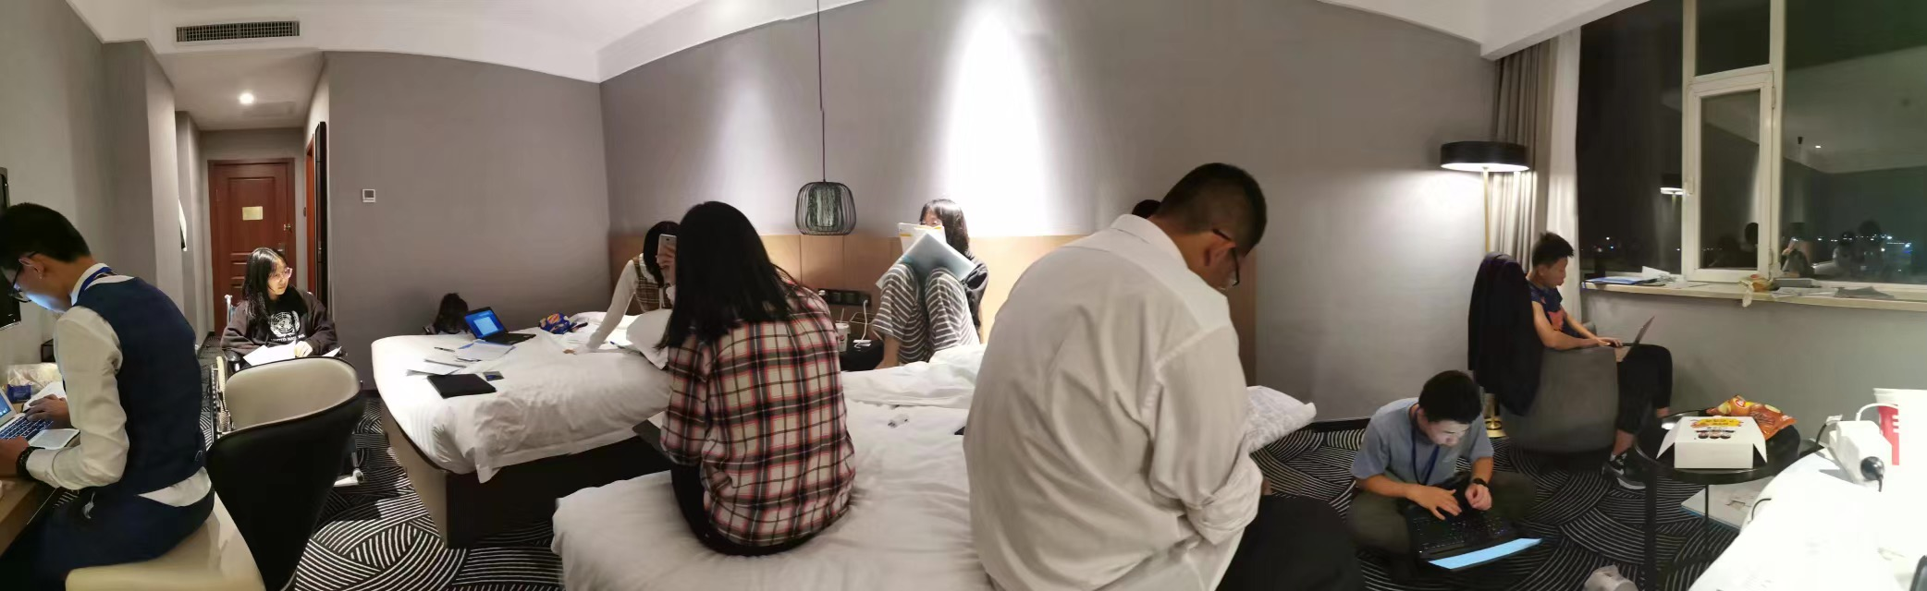
What is a Bloc?

Slide 9

Page
Volunteers pass the pages during the meeting

Slide 10
Points & motions
Dais : Are there any points or motions on the floor?
DEL : Point / The Delegate of … motions for …

Slide 11
Point
Points of personal privilege -- Personal discomfort or requirements affecting
others(ANY TIME)
2. Points of order -- Indicate an instance of improper procedure(LIMITED)
3. Points of inquiry --Ask the Chair a question regarding the rules of procedures
(NO ONE IS SPEAKING)

Slide 12
Motions
Shorten / lengthen the speaking time
Close the debate Suspend the meeting
Moderated Caucus
Un-moderated caucus
Postpone / resume DR

Slide 13
Moderated caucus
Delegate: Delegate of South Africa would like to motion for a moderated caucus. The subject is private sector’s duty to cope with climate change. The total time should be ten minutes and each speaker is entitled one minute.

Slide 14
Un-moderated caucus
Delegate: Delegate of China would like to motion for an un-moderated caucus lasting five minutes.

Slide 15
Voting
SIMPLE(1/2) MAJORITY | ABSOLUTE(2/3) MAJORITY
Motion for Moderated Caucus | Motion to Temporarily Close the Debate
Motion for Un-moderated Caucus | Motion to Close the Debate
Motion to Suspend the Meeting | Motion to Postpone a DR
Motion to Resume a DR | Unfriendly Amendment & Draft resolutions
Motion to Reorder DRs

Slide 16
Documents
PP – Position Paper
WP– Working Paper
DD– Draft Directive
DR– Draft Resolution

